Slide 1

COMPUTER NETWORKS (BCSC 0008)
Copyright content, use only with the written permission of presenter mentioned
DATA LINK LAYER FRAMING

Slide 2
Text and Reference Books
Text Books:
Fourouzan B. A. (2004), “Data Communication and Networking”, 4th Edition, McGraw-Hill.
References:
Kurose, J. F. and Ross K. W. (2005), “Computer Networking: A Top-Down Approach Featuring the Internet”, 3rd Edition, Addison-Wesley.
A. S. Tanenbaum (2006), “Computer Networks”, 2nd Edition, Prentice Hall India.

Slide 3
Previous discussed topics:
OSI Model
TCP/IP Model
Addressing
Data & Signals
Transmission Media & Line Encoding
Switching & Multiplexing
Now we will discuss:
Data Link Layer - FRAMING

Slide 4
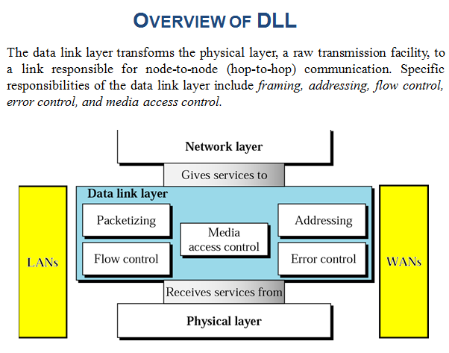

Slide 5
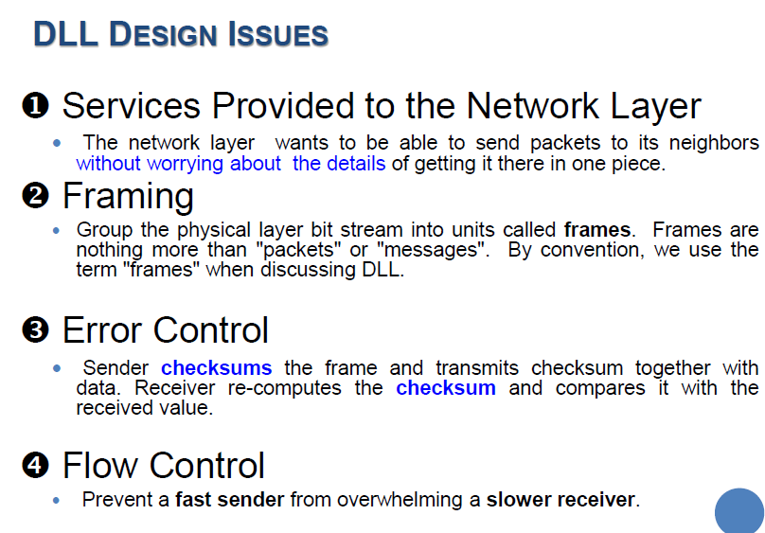

Slide 6
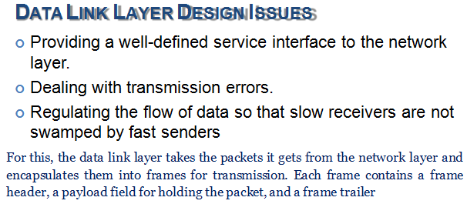
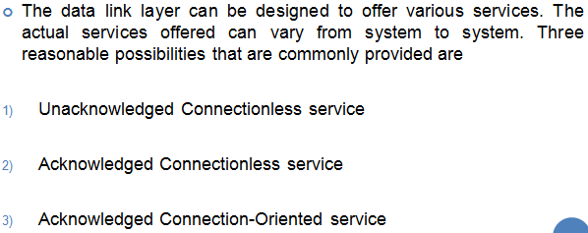

Slide 7
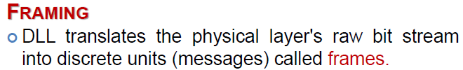
FRAMING
The data link layer needs to pack bits into frames, so that each frame is distinguishable from another. Our postal system practices a type of framing. The simple act of inserting a letter into an envelope separates one piece of information from another; the envelope serves as the delimiter.

Slide 8
FRAMING
To define boundaries of messages for distinguishing from other messages and signal.
Classification of FRAMING
Fixed-size framing:
Variable-size framing:
Character-oriented protocols
Bit-oriented protocols

Slide 9
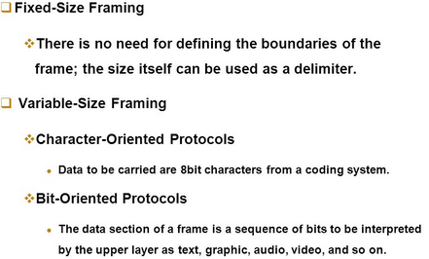
FRAMING

Slide 10
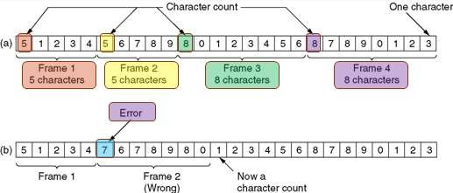
FRAMING – CHARACTER COUNT ( Character Oriented)
The framing method that uses a field in the header to specify the number of characters in the frame. When the data link layer at the destination sees the character count, it knows how many characters follow and hence where the end of the frame is.
The trouble with this
transmission error.
algorithm
is that
the count
can be garbled by a
11

Slide 11
FRAMING – CHARACTER COUNT
What if a header is garbled?
D can not tell where the following frames are.
Retransmission does not work either.
No one uses this method for the network communication that is supposed to be unreliable.

Slide 12
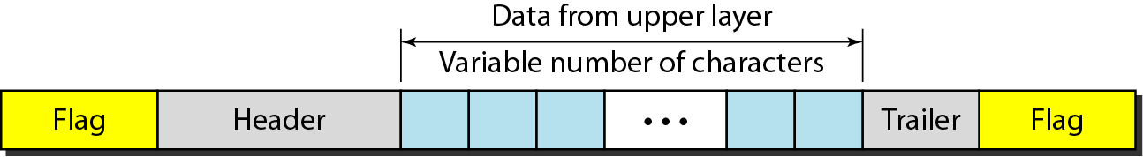
Character-Oriented Protocols
To use special characters to indicate the beginning and the end of a frame
Good for exchanging text messages, but what if other type of information (graph, audio, video) that can carry any character pattern even same as the special character.

Slide 13
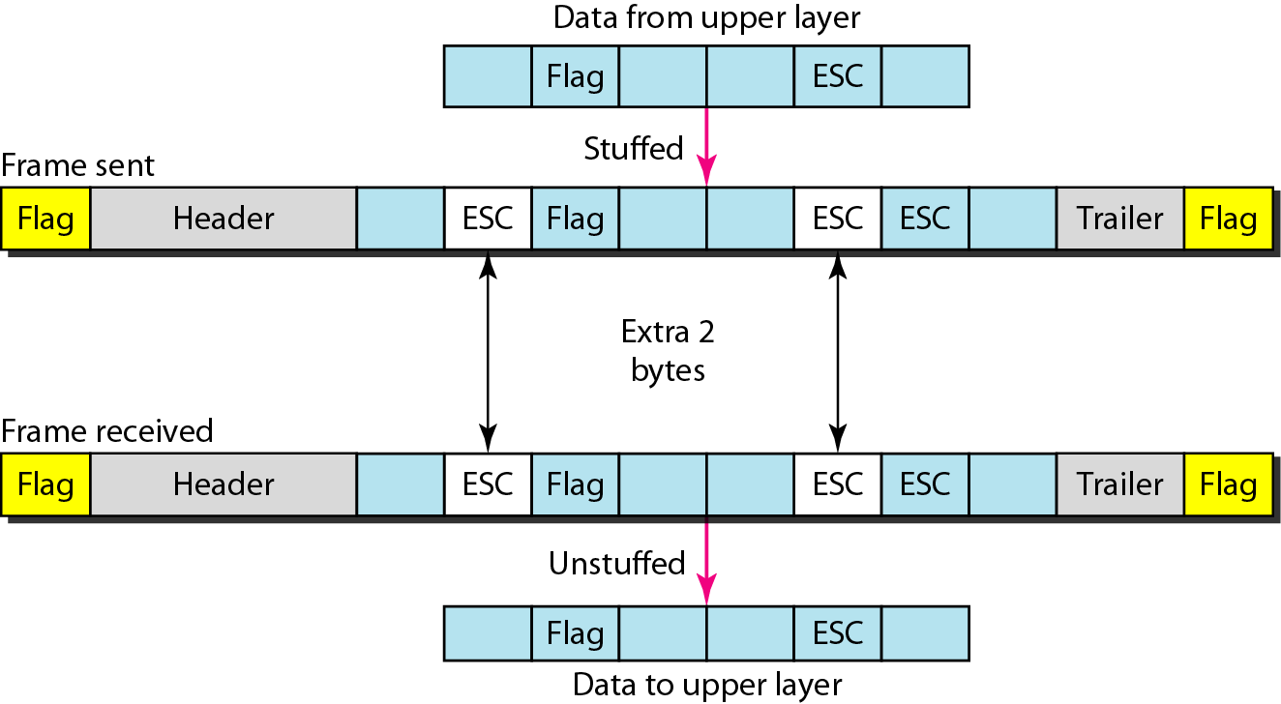
Character-Oriented Protocols
Byte-stuffing : Byte stuffing is the process of adding 1 extra byte whenever there is a flag or escape character in the text.

Slide 14
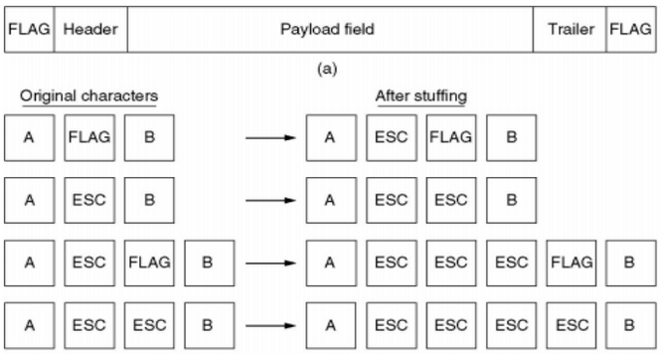
Character-Oriented Protocols
Byte stuffing is the process of adding 1 extra byte whenever there is a flag or escape character in the text.

Slide 15
Question 1:
Considering “f” as flag delimiter and “e” as DLE (escape) character, Apply the byte stuffing on the single frame data
five apples and four pears
fefivee applees and efour peearsf

Slide 16
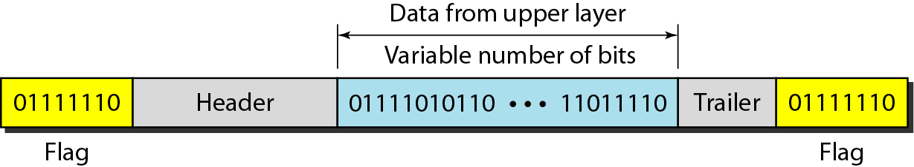
Bit-Oriented Protocols
Consider a frame as a sequence of bits.
Add special bit-pattern (e.g. 01111110) at the beginning and the end of a frame.

Slide 17
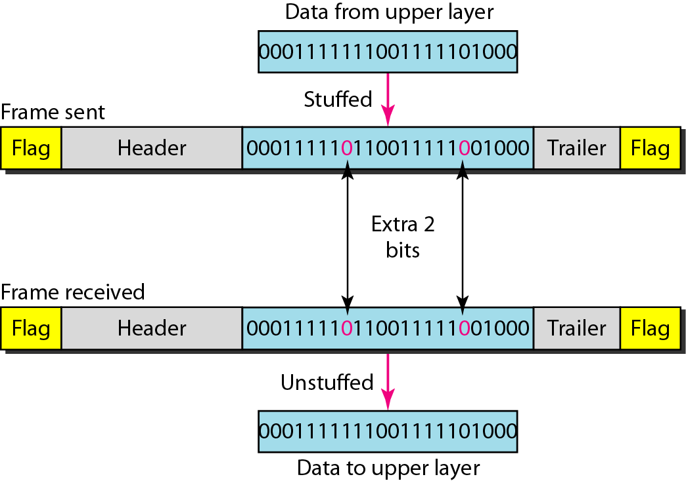
Bit-Oriented Protocols
The data may contain THE special bit-pattern from the upper layer.
Bit stuffing is the process of adding one extra 0 whenever five(5) consecutive 1’s follow a 0 in the data, so that the receiver does not mistake the pattern 0111110 for a flag.

Slide 18
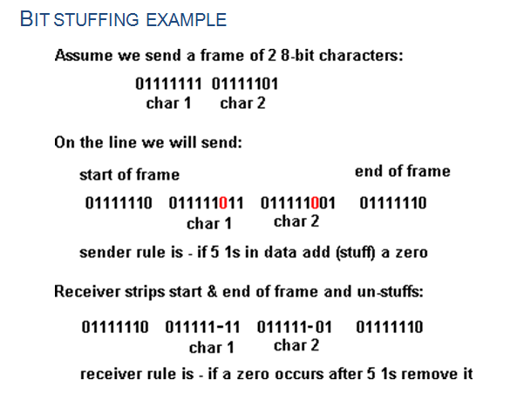
Bit-Oriented Protocols
Bit stuffing is the process of adding one extra 0 whenever five consecutive 1s follow a 0 in the data, so that the receiver does not mistake the pattern 0111110 for a flag.

Slide 19
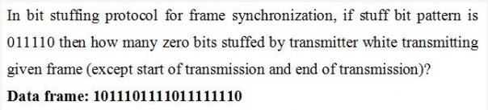
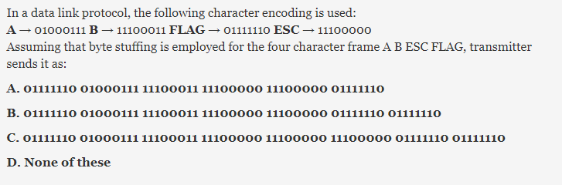
Question 1
Question 2

Slide 20
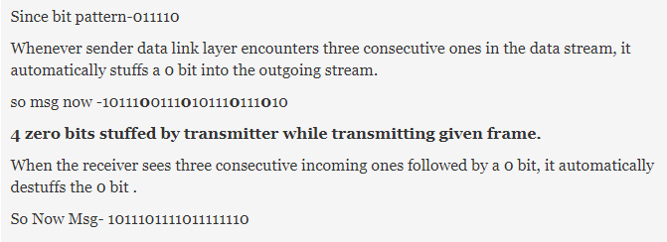
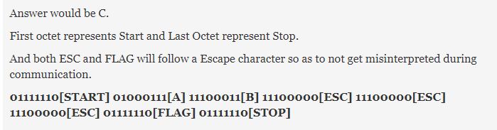
Solution 1
Solution 2

